Slide 1

Microwave Tracking Ground Station (MTGS)
Team Members: Clay Edwards Christian Ogburn Jared O’Shea Jusefs Saade Jordan West Ian Wolfe
Product Owner: Dr. Eduardo Rojas

Slide 2
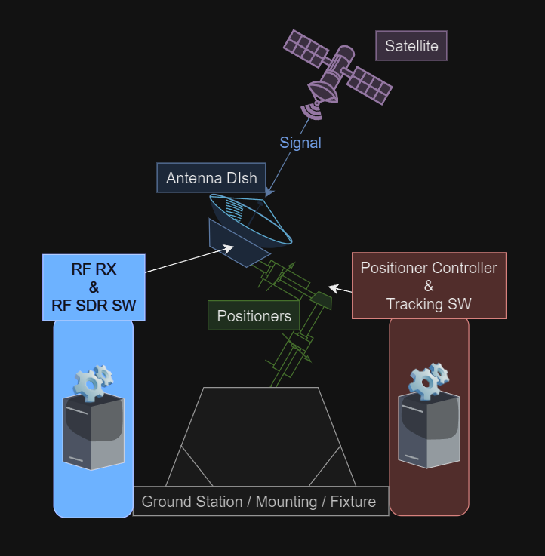
Summary of Project
Our mission is to track and receive signals from an S-Band frequency satellite.
The system is composed of five subsystems: A mount, positioner, tracking software, antenna, and software-defined radio (SDR)
Our focus this semester is tracking, setting up arriving hardware for testing and testing existing hardware

Slide 3
Project Background
This MTGS project has been recurring for multiple semesters
Previous team was able to track, but not receive signals from satellites
Very bulky design
Biggest issue was they could not get enough gain at the antenna to separate signal from noise
This semester, our team still aims to miniaturize design with the purchase of a new positioner (awaiting department approval) and mount for easy portability

Slide 4
Sprint Overview
Contingency plan to adjust for scope
Defined Team Roles
Antenna Selection
RF Block
Polarization Converter
Bandpass Filter
Low-Noise Amplifier
SDR Testing
Secured two weekly meetings with WiDE Lab member on previous MTGS team

Slide 5
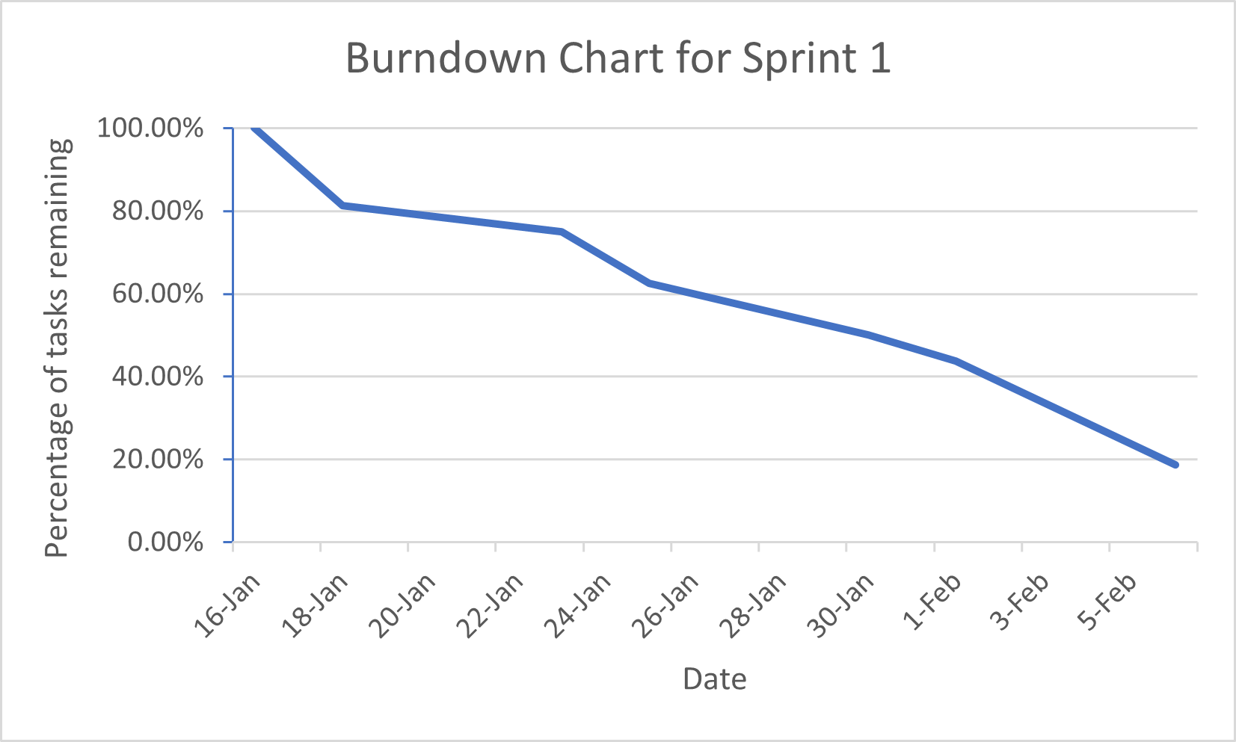
Trello/Backlog

Slide 6
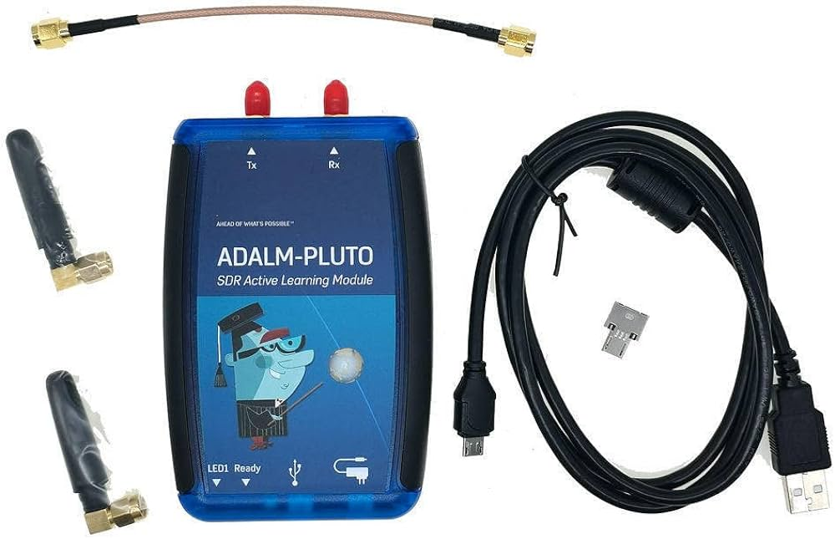
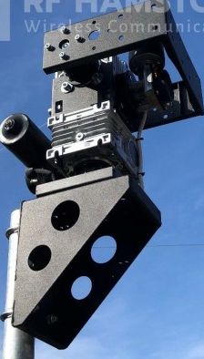
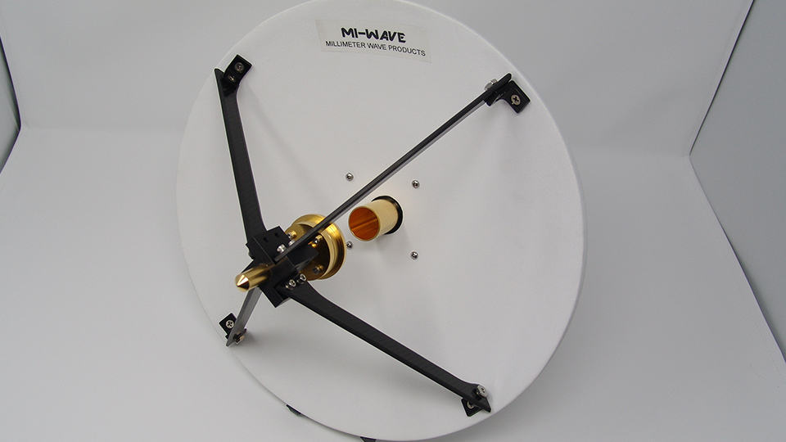
Hardware:
Positioner - SPX-01/HR
Antenna - MI-WAVE (Millimeter Wave Product Inc)
SDR Module - ADALM PLUTO
Mount - Tripod Pole Frame

Slide 7
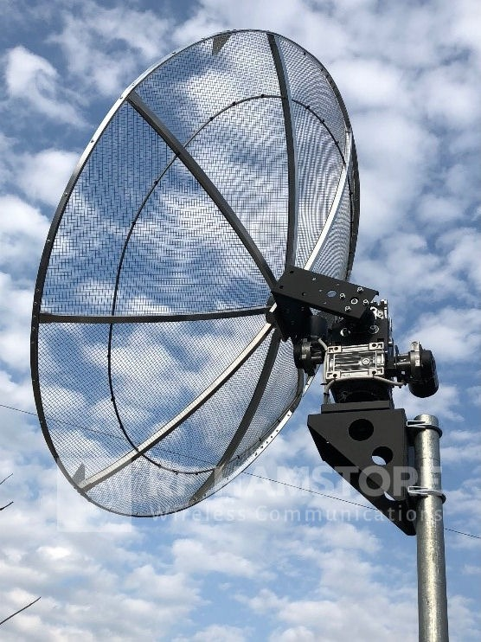
SPX-01/HR Positioner
(360º) Azimuth & (180º) Elevation Rotors
0.1875º Angle of Resolution
5.3º/s Rotation Speed
12.8kg (~28 lbs)
Max. Vertical Load: 30kg (~66 lbs)
Includes:
12V, 10/22A Power Supply
Controller – Built in USB tracking interface
Manual or Programmed Autonomous
TCP/IP Module for input application directly from internet
Pole-mast mounting bracket

Slide 8
Antenna RF Block Design
Objective: optimize signal reception by our antenna, to ensure high-quality communication.
Components: Low Noise Amplifier (LNA), Bandpass Filter, Circular Polarization.
Circular Polarizer (90 deg shift)
Bandpass Filter
Incoming Signal
LNA
SDR
S-Band Antenna
RF Block
To Do:
Analyze current antenna.
Get list of satellites with transponders matching our frequency range.
Perform RF Block design (polarizer, stepped impedance filter) using Ansys, ADS.
Make Link Budget.

Slide 9
Project Link Budget Analysis
Objective: ensuring reliable communication between satellite and ground station; calculating necessary signal strength and quality.
Key variables: TX && RX powers, gains, losses, and noise figures.
P_{rx} = P_{tx} + G_{tx} + G_{rx} - L_{tx} - L_{rx} - L_{fs}
L_{fs} = free space path loss = 20 log₁₀( 4π (d ⁄ 𝛌))
LM = (P_{rx} - RS) > 0
RS = receiver sensitivity
To Do:
RF Block && Antenna: Power, gain and loss using MATLAB.
Ensure reliable communication.

Slide 10
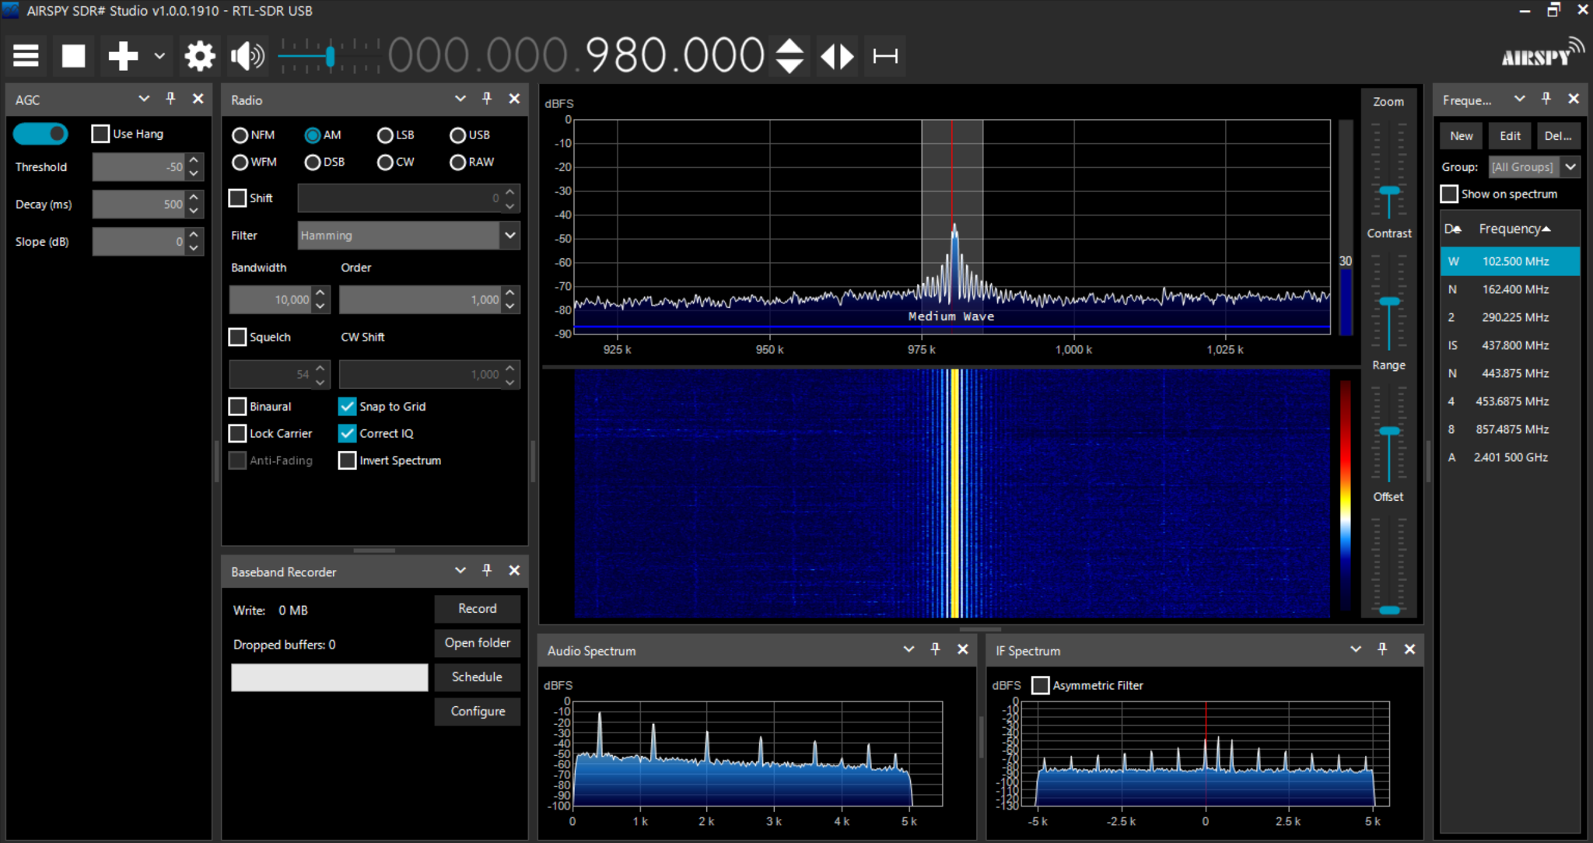
SDR Testing/Software
Confirmed SDR and Software Functionality
Considering switching to MATLAB
Recording Functionality
More useful Demodulation Libraries

Slide 11
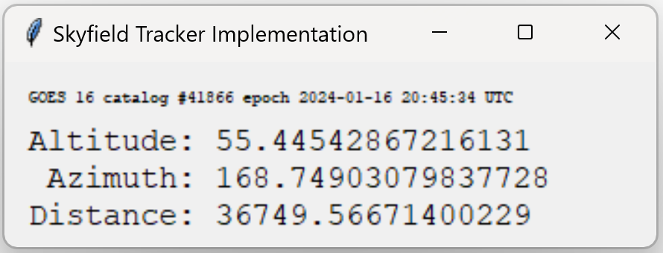
Tracking Software
Python program outputs the altitude and azimuth angles for viewing the satellite
Plan to use HamSat software for positioning
Turning away from tracking problem until we receive hardware

Slide 12
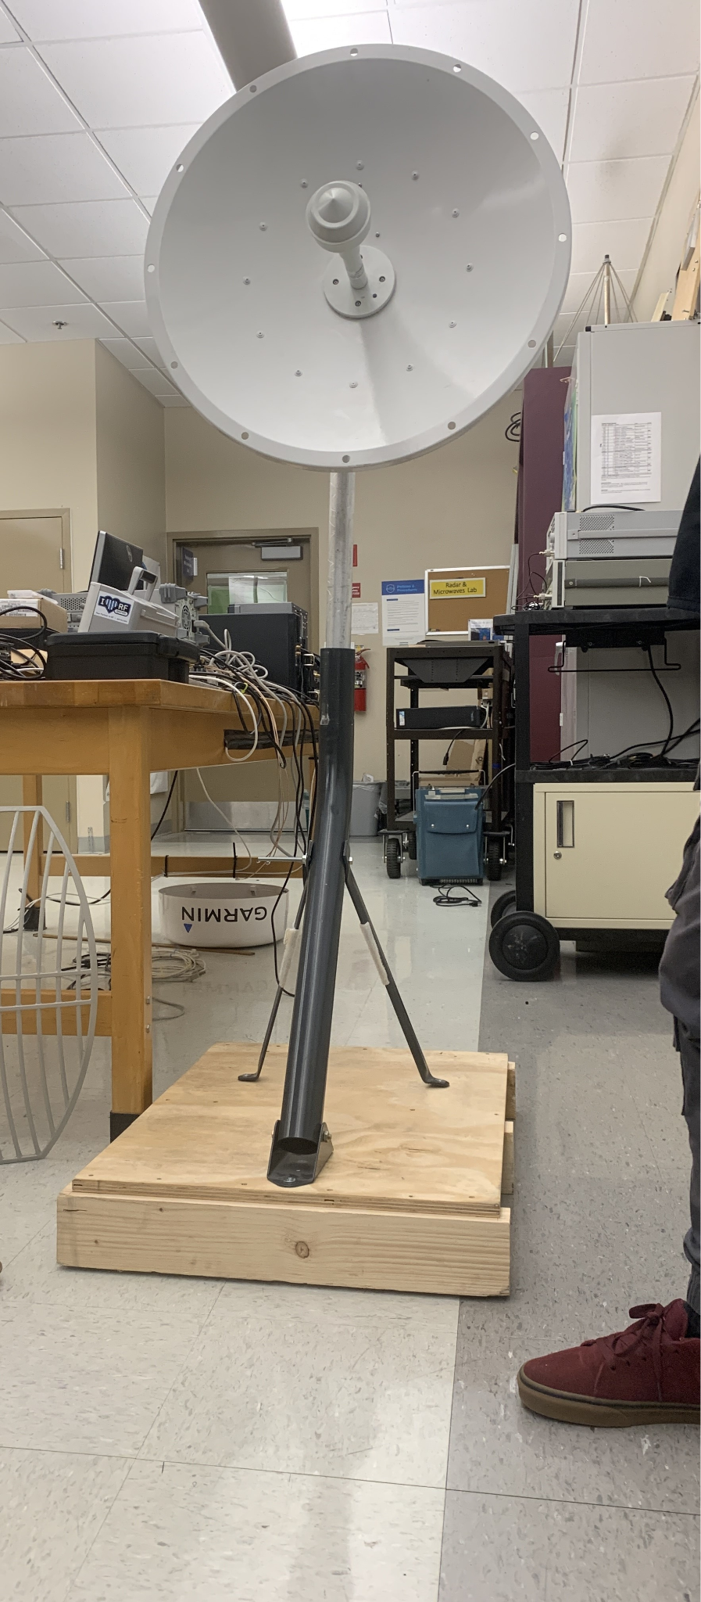
Contingency
We are currently testing the previous team’s ground station (pictured) while we wait for department approval for hardware purchase.
In the event we don’t receive our parts on time, we will focus on implementing tracking algorithms to align the positioner with a satellite, even if a signal is not established.

Slide 13
Demodulation
This a secondary objective for our project group at the time of this demo and has just begun development
The goal being to demodulate the signals using its schemes from the satellite and retrieve the original information in the signal
This part is mostly software oriented to signal and may require hardware based on the satellite signal we’re tracking

Slide 14
Questions
?

